Slide 1
Hardware Hackathon
DCU Innovation Campus – 22nd – 24th May 2015
Getting Started Workshop

Slide 2


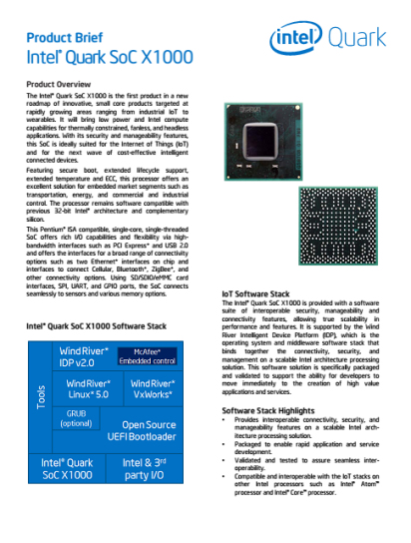
What Will You Make?
Intel® Galileo – Easily try out technology solution ideas
Intel® Edison - Create wearables and other products for the Internet of Things
Intel Facts
Global headquarters: Santa Clara, California
107,600 employees worldwide (at end of 2013)
55 percent of employees reside in the U.S.
Intel’s vision: This decade we will create and extend computing technology to connect and enrich the life of every person on earth

Slide 3
Session Goals
Get started with Galileo platform
What do I need ?
What software do I need ?
How do I configure it ?
Connect stuff
How do I configure the WiFi ?
How do I hook up devices to my board ?
How can I program stuff ?
Next Steps
How can I connect to the cloud ?
How do I know it all works ?

Slide 4
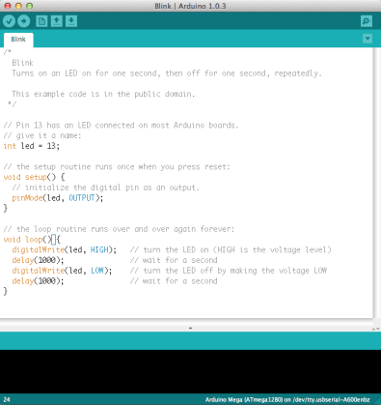
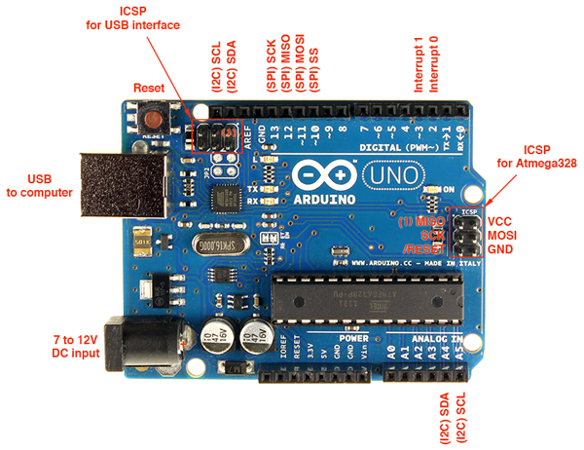
What is Arduino?
An open-source hardware and software platform for building electronics projects
A physical programmable circuit board (often referred to as a microcontroller)
A piece of software, or IDE (Integrated Development Environment) that runs on your computer, used to write and upload computer code to the physical board (supports Mac/Windows/Linux)

Slide 5
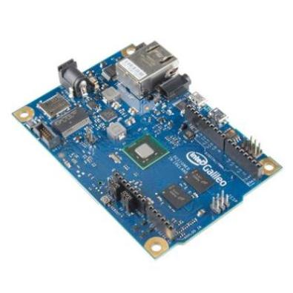
10 Great things about Galileo
Shield Compatibility WiFi/Ethernet Library Compatibility
Familiar Arduino IDE Real Time Clock
MicroSD Support USB Host Port
Serial Connectivity Linux on Board
Works with PCI Express Mini Cards TWI/I2C, SPI Support
Source Makezine: http://makezine.com/2013/10/03/10-great-intel-galileo-features/

Slide 6
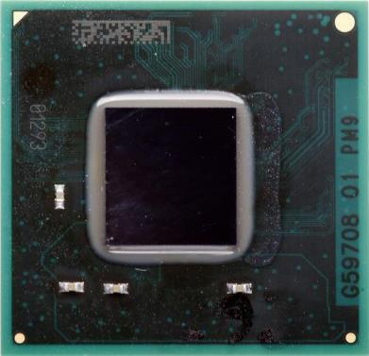
Intel® Quark SoC X1000 - Pentium compatible ISA
Processor Core
Single Quark CPU Core, Single Thread
32 bit, x86, @ 400MHz
Industry Standard Software Support
Standard Compiler Support (ICC/GCC)
Pentium ISA Compatibility (.586)
Runs unmodified Linux* Kernels (v3.8)
Yocto based distribution
Validated w WR IDP 2.0 (Linux & VxWorks)
Open Source UEFI EDK II
GRUB boot loader support
Open OCD Debugging support
Compliant with PCIe, USB, ACPI standards
Processor UnCore
DDR3 memory controller
Up to 2GB @ 800MTs
ECC-On-Chip (X1010/X1020)
Embedded 512KB SRAM
Legacy Block
PC compatible IO ports, APICs, etc.
20MHz Legacy SPI for boot code
Low cost 5-pin JTAG Port
Open Hardware Architecture
AMBA Bus fabric = Flexible Silicon IP
Physical
Package size 15x15mm
393 Pin, FC BGA bare die
0.593 Ball Pitch
Enables FR4 SFF Board
Security
Secure Boot Technology Option (X1020)
Supervisory Mode Execution Protection
Secure Recovery for UEFI FW
Secure Remote Upgrade w/ WR IDP 2.0
Industry Standard I/O Hardware
2 - x1 PCIe Gen 2**
2 - 10/100Mb Ethernet* MACs
2 - USB2 host ports (EHCI, OHCI)
2 - HS UART controller
2 – 50MHz SPI ports for peripherals
1 – USB2 HS Device port
1 - SD/SDIO/eMMC interface
1 – I2C/GPIO Host controller
16 - GPIOs w/ programmable interrupts
Thermals
TDP: 2W (VR dependent)
Tj = 110°C
Commercial Temp (WW46)
Ext temp -40 to +85°C (Q1’14)
Programmable Thermal sensor
Electricals:
Single xtal for internal/external clocks
Enabled Single std external VR solution
** PCIe Gen1 speed to save power

Slide 7
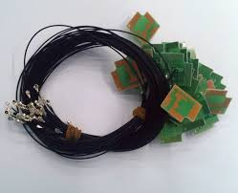
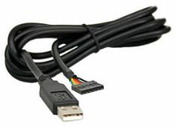
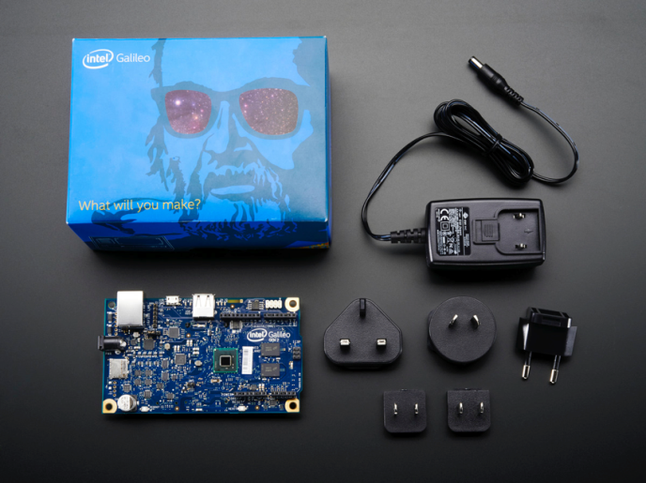
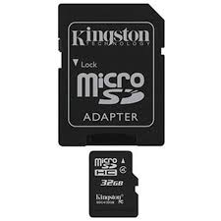
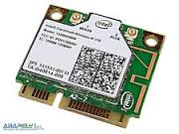
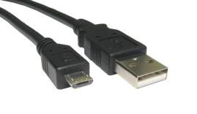
Hardware – What do you need……

Slide 8
Software available – 2 choices
SD Card Image will support both models
Arduino :
Traditional interface for the Maker boards
C++ based, primarily text based coding
Sketches are the currency of Arduino
Large range of libraries
Needed for Galileo initial configuration
Recommended for Novices
Node JS Based Software :
Java Based
More Visual Programming
Intel XDK
Node Red
Wyliodrin

Slide 9
Arduino
Software overview

Slide 10
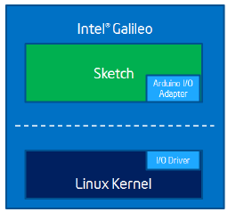
Arduino Software Compatibility
Familiar Arduino IDE with example sketches
Load Sketch from PC to Galileo

Slide 11
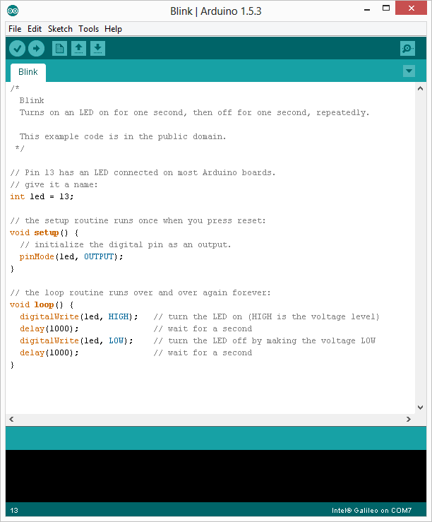
Sketch Overview
Comment Block
Comment
Global Variable
Code executed once on initial load
Code Loop ran continuously

Slide 12
Software Stack

Slide 13
Node JS
Standard SD Card Image can be used
Need to install Node.JS tools once the board is booted.
Can be done using SSH or USB key to copy files.
Files are available.
Once installed – it is possible to run .js files directly from command-line
We have some sample applications to use as a getting started framework

Slide 14

Intel® XDK – IoT Edition
https://software.intel.com/en-us/html5/xdk-iot
Notes:
Intel XDK IoT Edition simplifies IoT app development from design, test, to deployment on Intel Edison and Intel Galileo boards, and enables accompanying companion apps to interact with IoT devices in new ways. With Intel XDK IoT Edition’s advanced capabilities Makers get an integrated IoT development approach to: ▪ Create, run, and debug IoT applications using Node.js* on Intel Edison and Intel Galileo Boards ▪ Design HTML5 companion apps to interact with IoT devices from phones, tablets, PCs, or through cloud services This dual capability helps Makers speed time to a complete solution to reach millions of devices in new markets, from home automation, connected devices, transportation, to smart appliances, and more.
Integrated create, debug, and run tools for JavaScript* on-board application development • Enables easy on-board app development and deployment for many IoT devices • Utilizes Node.js* to define behavior of IoT device • Deploy, run, debug on IoT device with Node.js* • Quick start samples and templates for IoT • Integration with cloud, web services, and sensors through JavaScript* APIs • Secured SSH tunnel daemon support with user password or key-based authentication • SSH and Serial terminal connection support

Slide 15
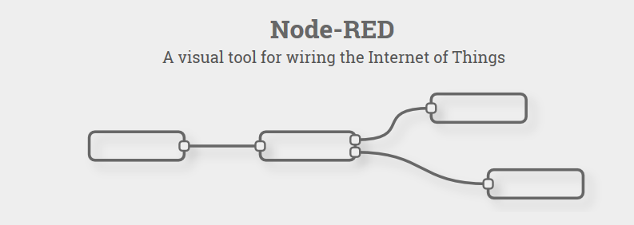
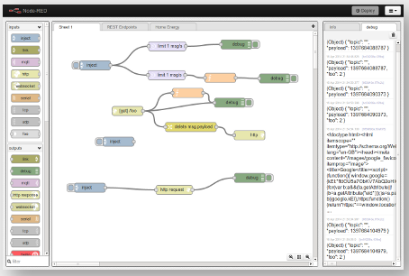
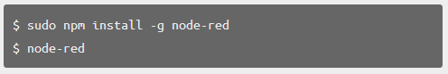
Node Red
http://nodered.org/
Notes:
Node-RED is a tool for wiring together hardware devices, APIs and online services in new and interesting ways.
Node-RED provides a browser-based flow editor that makes it easy to wire together flows using the wide range nodes in the palette. Flows can be then deployed to the runtime in a single-click.
JavaScript functions can be created within the editor using the a rich text editor.
A built-in library allows you to save useful functions, templates or flows for re-use.
The light-weight runtime is built on Node.js, taking full advantage of its event-driven, non-blocking model. This makes it ideal to run at the edge of the network on low-cost hardware

Slide 16
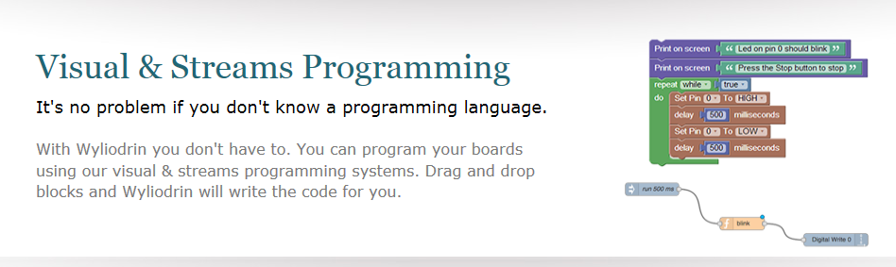
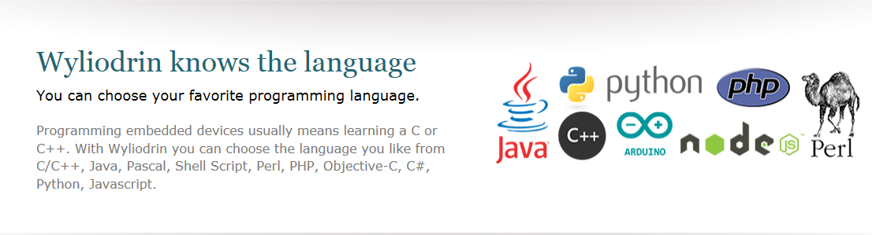
Wyliodrin
https://www.wyliodrin.com/
https://projects.wyliodrin.com/wiki/boards_setup/arduinogalileo
Notes:
Wyliodrin is a service that allows you to visually create applications for your board and control it directly from the browser.
With the Wyliodrin service you can create applications for your board without having to:
Connect your board to a monitor, keyboard and mouse
Use SSH to connect to it
Know a programming language (C, Java or Python) in detail
Search for drivers of sensors etc
Visual Programming allows you to create applications without having to write the code yourself. You just drag and drop your desired pre-defined application components (blocks) to create the application you want.

Slide 17
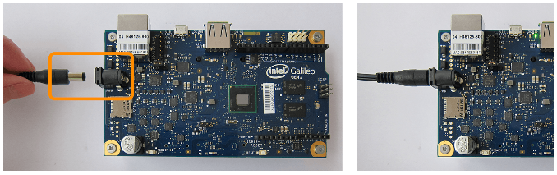
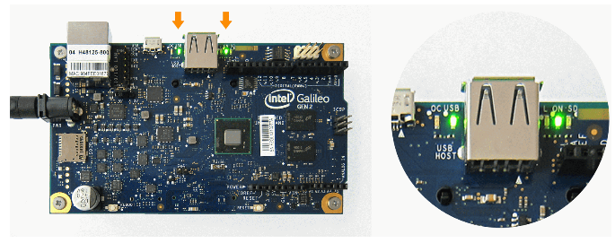
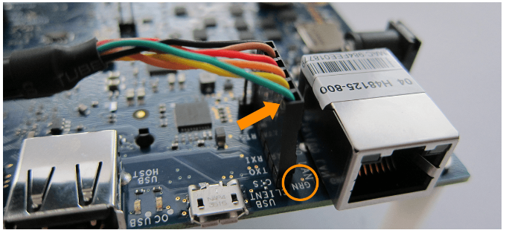
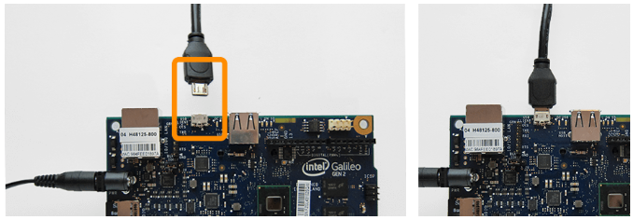
Powering Up the board

Slide 18
Initial Configuration & Board Test
Install Arduino 1.0.4 software on Host Computer – Close to root
Select Galileo Gen2
Select COM Port ( Micro USB – add pic )
Perform Firmware Update – Help -> Galileo Firmware Update
Takes about 5 minutes – Popup will notify you of success
Test that board is working & functional
Load Blink Example – File -> Examples -> 01-Basics -> Blink
Download Blink Sketch to target
Green LED should start to blink @ 1sec interval

Slide 19
WiFi Setup
Make sure you have the Micro SD Card Inserted
Boot the system
Open Serial Terminal Window for COM port ( FTDI UART ) – add pic
Login = root – no password
Once in Commandline –
Enable WiFi with following command – ifup wlan0
Add pic for config output
Revert back to Arduino IDE
Load – File -> Examples -> WiFi -> ScanNetworks
Download to Galileo
For the Datafest Hackathon – please use SSID – Hackathon – open network

Slide 20
You are Ready to Begin ☺

Slide 21
Serial Communication
2 Available UART Interfaces
3V3 TTL UART
Micro USB Serial
Can be used to communicate directly with the board
Act as debug interface
Used by Arduino Interface to connect & communicate.
Can be used for general purpose communication to other serial devices.
Let’s see how it works…….

Slide 22
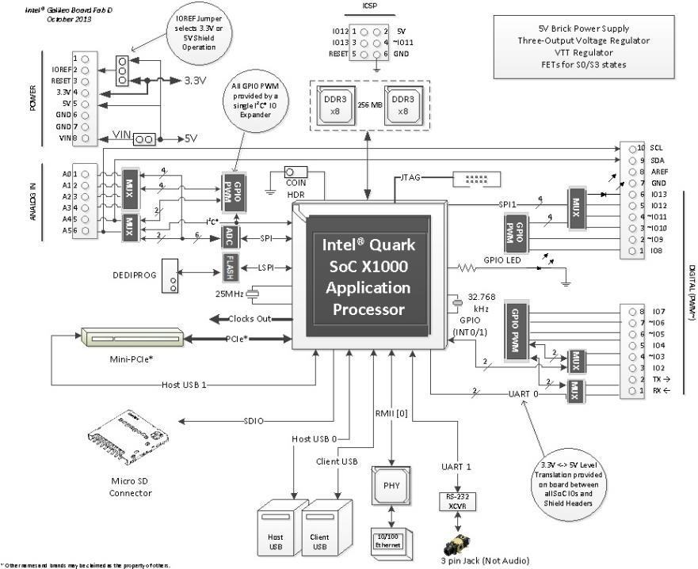
Interfaces Available – Arduino Rails
Pulse Width Modulator
Analogue Digital Convertor
Digital Input / Output
UART
I2C
SPI

Slide 23
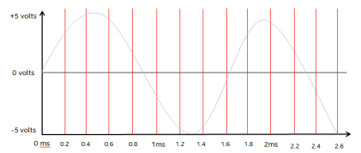



Controlling The I/O
Digital Input / Output
These are used to control single digital singles & can be set to either output a signal or receive a signal.
Uses – reading input signals like switches, controlling outputs LEDs, Motors, Relays
Analogue Digital Converter
12 bit accuracy, 6 channels available through Arduino pins
ADC sampling at 5kHz- take a ‘snapshot’ of the voltage level every 200uS
PWM – Pseudo Analogue Outputs
PWM stands for Pulse Width Modulation
Used to get analogue results by digital means
Sends pulses of power to simulate voltage
The duration of high power is know as the ‘Pulse Width’

Slide 24
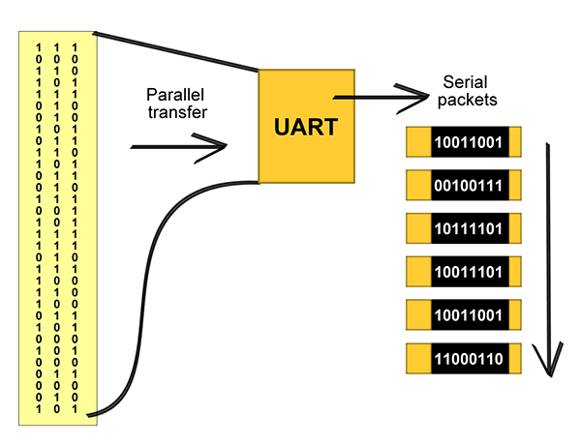
Controlling the I/O
UART
UART stands for Universal Asynchronous Receiver/Transmitter (UART)
It is a piece of computer hardware that translates data between parallel and serial forms.
The universal designation indicates that the data format and transmission speeds are configurable.
It takes bytes of data and transmits the individual bits in a sequential fashion.
At the destination, a second UART re-assembles the bits into complete bytes.
Second UART available Arduino pins
I2C
I²C stands for Inter-Integrated Circuit
It is a bus used for attaching low-speed peripherals to computer motherboards and embedded systems.
See http://en.wikipedia.org/wiki/I%C2%B2C for more information.
Low speed data communication
Collecting data from sensors and other devices.
Available through Arduino pins

Slide 25
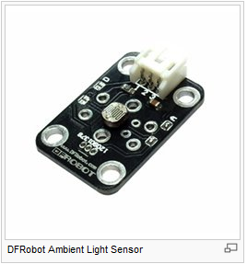
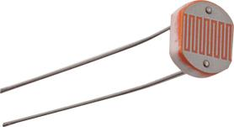
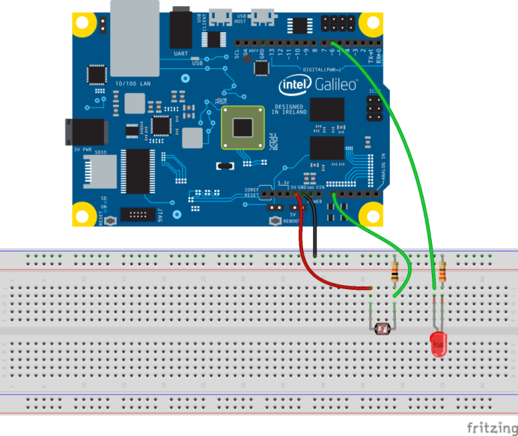
Adding a Sensor
#define A_PIN 0 //analog pin for LDR
#define D_PIN 6 //digital pin for LED
int value;
void setup() {
pinMode(D_PIN, OUTPUT);
}
void loop() {
value = map(analogRead(A_PIN), 0, 1023, 0, 255);
analogWrite(D_PIN, value);
}
Light Distance Temperature Acceleration Vibration
Motion Touch Gas
Sound
Etc….
Great breadboarding tool – fritzing
http://fritzing.org/home/

Slide 26

How does this get communicated ???
Galileo has Ethernet & WiFi cabability
For the datafest, IBM have laid on a free to register Cloud access to their Bluemix service – http://datafest.mybluemix.net/?cm_mmc=IBMEcoDNA-_-IICSVL-_-outbound-_-Datafest2015
https://console.ng.bluemix.net/home
Portal uses MQTT Broker to communicate to devices - http://mqtt.com/
Note :- Arduino native MQTT library needs to be modified to work on Galileo – we have the library here ☺
For testing purposes, there is a test portal to validate that data is being sent.
https://quickstart.internetofthings.ibmcloud.com/#/

Slide 27


Let’s see how it works…….

Slide 28
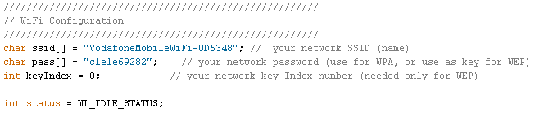
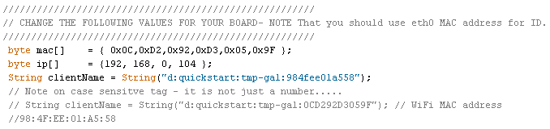
Let’s look at a simple MQTT Test
Setup Temperature Sensor input to A0 of Galileo
MQTT application is written for Arduino & Node.js
Notes :-
Setup WiFi connection
All you need is SSID & Passphrase
Configure MQTT Session
Client Name format
d:quickstart:<name>:mac
Max length 34 characters
MAC address is that of the ethernet port
MAC address is case sensitive – consistent cut & paste needed ☺

Slide 29
Lets Get Started! https://github.com/global-urban-datafest/datafest_dublin_helper_files

Slide 30
Arduino Shields
There are hundreds of shields available from dozens of suppliers
GSM/Wifi/Bluetooth Ethernet/GPS
Battery/Solar RS232/RS485
RFID/Xbee/NFC SD/EEPROM
Midi/WAV/MP3 Camera/Video/Home
Sensors/LCDs Robotics/Fun/Actuators
shieldlist.org
adafruit.com
cooking-hacks.com
sparkfun.com
store.arduino.cc
cutidigi.com
etc

Slide 31
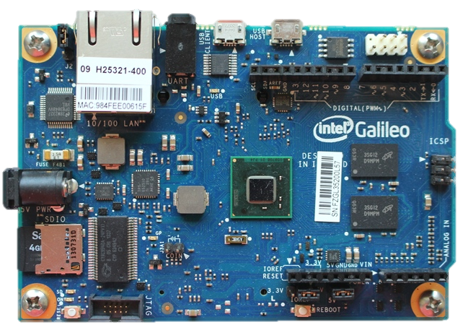
Reboot and Reset Button Differences
Reset Button
Restart the Arduino sketch running on the Galileo. Includes re-executing the code defined within the Setup section
Acts much more like the reset button you may be used to
Reboot Button
Will reboot the entire Galileo - Linux included
Boot time is about 30 seconds, so don’t press this accidentally!

Slide 32
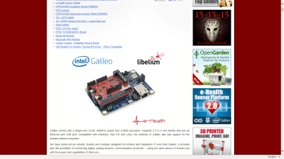
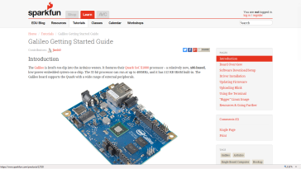
Galileo Support
Galileo Support
http://www.intel.com/content/www/us/en/do-it-yourself/galileo-maker-quark-board.html
Galileo support site: http://www.intel.com/support/galileo/
How to videos: http://www.intel.com/support/galileo/howtovideos.htm
Intel Maker community: https://communities.intel.com/community/makers
Documents: https://communities.intel.com/community/makers/documentation/galileodocuments
Data sheet: https://communities.intel.com/docs/DOC-21835
Board User Guide: https://communities.intel.com/docs/DOC-22475
Drivers: https://communities.intel.com/docs/DOC-22226
There are many Galileo communities e.g.
Sparkfun getting started guide: https://learn.sparkfun.com/tutorials/galileo-getting-started-guide
Using Galileo with Arduino shields: http://www.cooking-hacks.com/documentation/tutorials/intel-galileo-tutorial-using-arduino-and-raspberry-pi-shields-modules-boards

